Slide 1
Hand Gesture Controlled Car
An Innovative Approach to RC Car Control

Slide 2
Introduction :
To introduce a car controlled by hand gestures, utilizing advanced sensors for gesture detection.
Showcases how modern sensor technology enables a seamless and intuitive control interface, paving the way for future advancements in user interaction with technology.

Slide 3
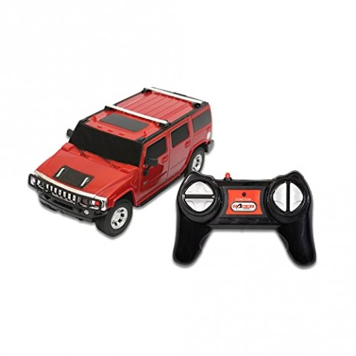
Old Technology
Traditional RC Cars:
Control Method: Operated with physical remotes featuring buttons or joysticks.
Components:
Remote Control: Uses RF or infrared signals.
Receiver: Installed in the car to receive commands.
Motor Driver: Executes motor control based on received signals.

Slide 4
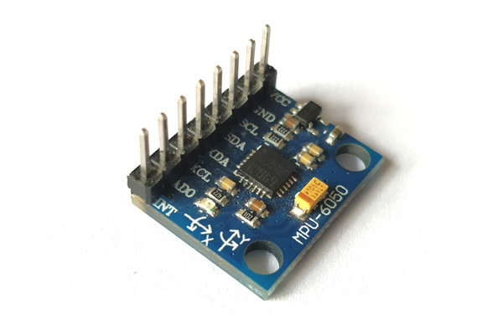
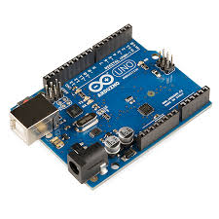
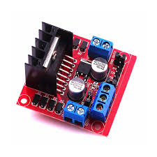
New Technology
Hand Gesture Control:
Control Method: Utilizes sensors to detect hand movements and convert them into car commands.
Components:
Gesture Sensors: MPU6050 (accelerometer and gyroscope) or potentiometers.
Microcontroller: Arduino Nano/Uno to process sensor data and control motors.
Motor Driver: L293D or L298N to drive motors based on sensor inputs.

Slide 5
Implementation :
Goal: To create an RC car that responds to hand gestures using the MPU6050 sensor for gesture detection.
Assemble the Car: Install the MPU6050 sensor, Arduino, and motor driver on the chassis and attach the motors.
Wire Components: Connect the MPU6050 to Arduino, and link the motor driver to both the motors and Arduino.
Develop and Upload Code: Program the Arduino to interpret MPU6050 data and manage motor responses to gestures.
Testing and Calibration: Fine-tune the sensor and code adjustments to achieve precise gesture control and vehicle operation.
https://www.tinkercad.com/things/k41zoPndFrd-car-moving-using-hand-gestures

Slide 6
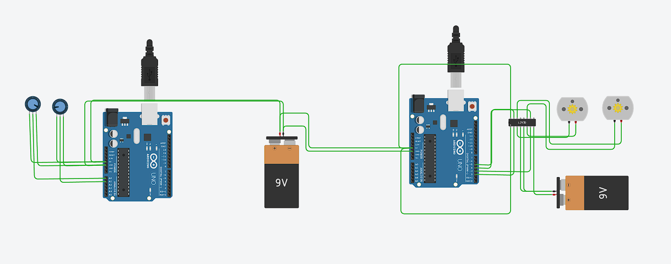
Example in TinkerCad

Slide 7
Conclusion
Demonstrated how hand gestures can be used to control an RC car, enhancing the control experience with modern technology.
Potential enhancements could include refining gesture detection, adding more complex gestures, or integrating additional sensors.

